Slide 1
Career counselling companion agent
IBM AICTE PROJECT
Presented By:
Student name :POTHANA PARDHU
College Name & Department
College Name : VAAGDEVI COLLEGE OF ENGINEERING
Department : CSE(AI&ML)

Slide 2
OUTLINE
Problem Statement
Technology used
Wow factor
End users
Result
Conclusion
Git-hub Link
Future scope
IBM Certifications

Slide 3

Problem Statement
Many students find it hard to choose the right career path after school or college. They often don’t know what they’re good at, what jobs are in demand, or which courses will help them get there. The guidance they receive is often general, outdated, or not tailored to their individual strengths and goals.
Proposed Solution :
A smart AI Career Counseling Agent that:
Learns about the student’s interests, strengths, and academic performance
Tracks current job trends, skills in demand, and future career opportunities
Gives personalized advice on courses, colleges, and career paths

Slide 4








Technology used
IBM cloud lite services
IBM Watsonx.ai
Agent Lab
Machine Learning Model
Lang chain / Lang Graph
IBM Granite model
IBM Cloud Object Storage

Slide 5

IBM cloud services used
IBM Cloud Watsonx AI Studio :
For training and deploying your AI models
IBM Cloud Vector Database(Watsonx) :
To store and retrieve contextual knowledge (RAG)
IBM Cloud Watsonx AI runtime :
To host and run our AI assistant in production
IBM Cloud Agent Lab :
To configure and manage agent workflows
IBM Granite foundation model :
For advanced LLM capabilities (NLP, reasoning, etc.)
IBM Cloud Object Storage :
To store PDFs, course lists, career data, datasets, and user session logs

Slide 6
Wow factors
This smart career counselling companion agent helps students save time, gain clarity, and make confident career choices. Whether you're unsure about what to do after 12th or exploring future paths, it gives you personalized, up-to-date guidance in a simple and friendly way.
Unique features:
It listens to what you love- your favorite subjects, hobbies and strengths- and helps you find careers that truly suit you.
It guides you to the right courses and colleges, so you can start your journey with confidence
It keeps track of job market trends and in-demand skills, making sure you're always future-ready
If you ever feel stuck it shows you the learning paths and it connects you with the right mentor and keeps move you forward

Slide 7
End users
Parents and guardians
Educators
Teachers and mentors aiming
School and college counsellors
Professionals who provide academic and career advice , now empowered with intelligent tools for deeper insights
Students
Young individuals exploring career paths based on their interests, strengths and their Academic performance
Supportive figures seeking clarity and guidance to help their children making best career decisions
to align student learning with
future career opportunities
and industry trends

Slide 8
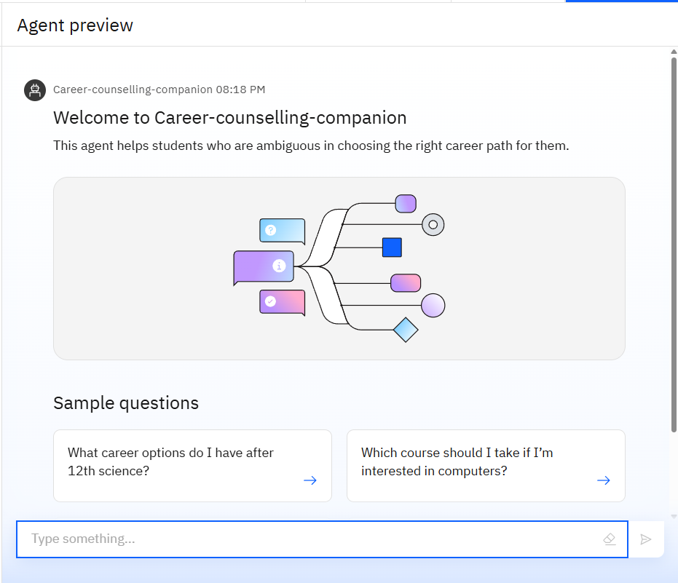
Results
Welcome screen Displays the agent’s introduction and sample questions.
It showcases its user-friendly interface designed for student/user queries.

Slide 9
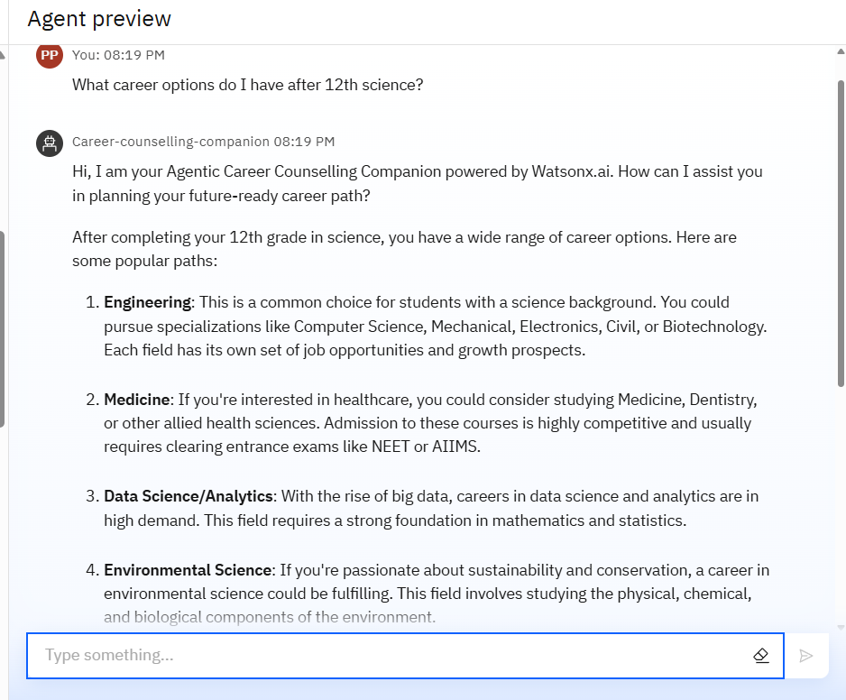
Results
The agent dynamically lists STEM career paths (e.g., Engineering, Medicine) with exam details (NEET/AIIMS).
The agent dynamically lists STEM career paths (e.g., Engineering, Medicine) with exam details (NEET/AIIMS).

Slide 10
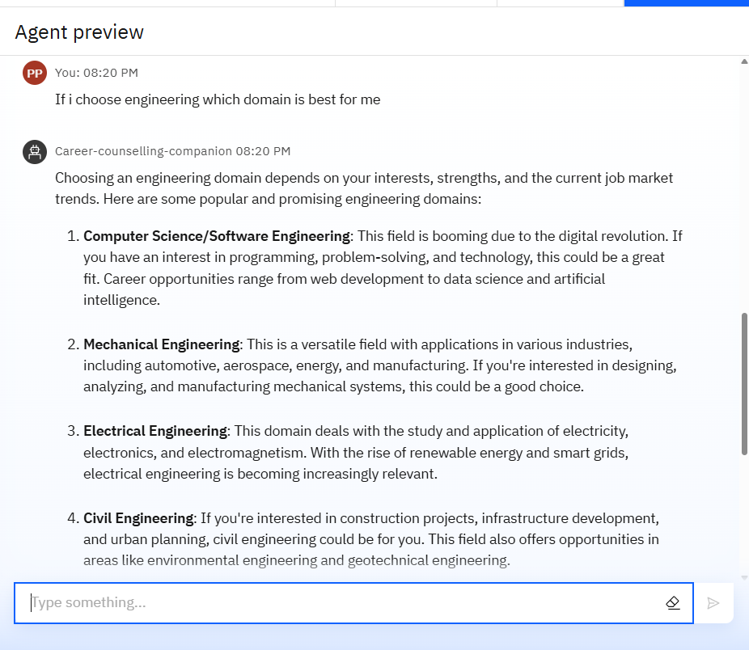
Results
Here the Agent Compares trending fields like Computer Science, Mechanical, and Electrical Engineering.
Suggests aligning choices with interests and market demand.

Slide 11
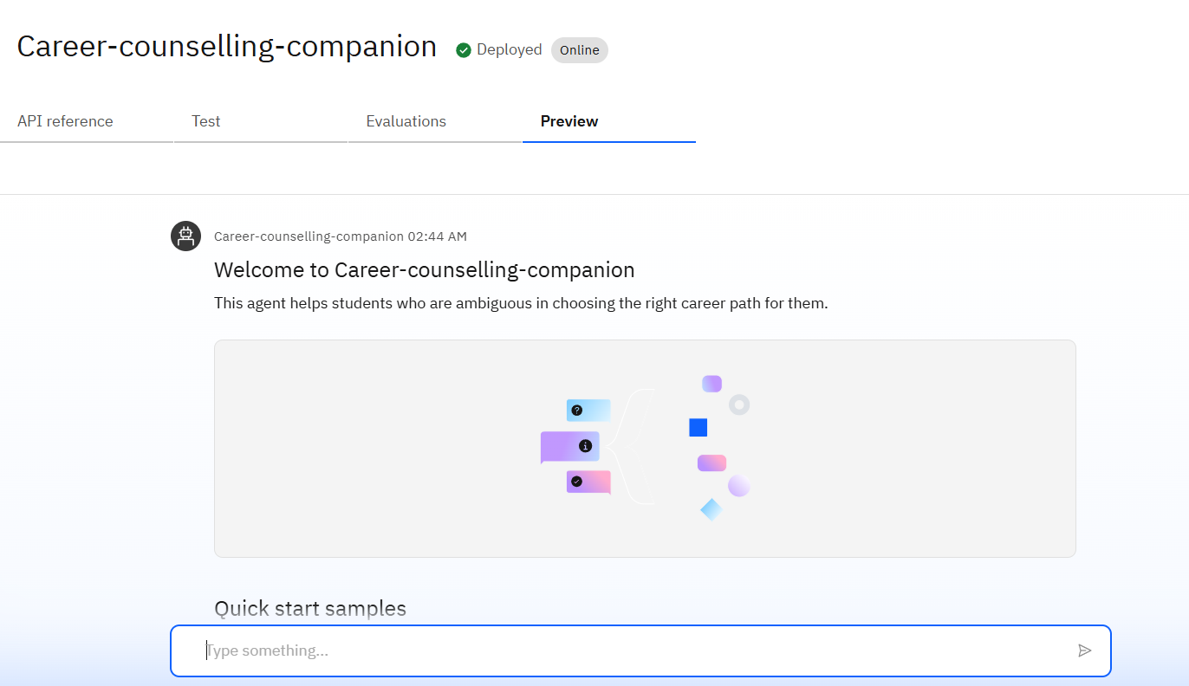
Results
Deployed Carrer counselling AI Agent
The above image shows the preview of the deployed career counselling companion agent.

Slide 12






Conclusion
Guides students toward well-matched career paths using their interests & strengths.
Reduces confusion and stress by simplifying decision-making with smart suggestions.
Automates course, college, and career recommendations using real-time market data.
Boosts students’ confidence and readiness for the future with timely insights.
Continuously learns and adapts to provide smarter, more personalized suggestions

Slide 13
Git-hub link
Git hub link : https://github.com/PothanaPardhu/Career-Counselling-Agent.git

Slide 14
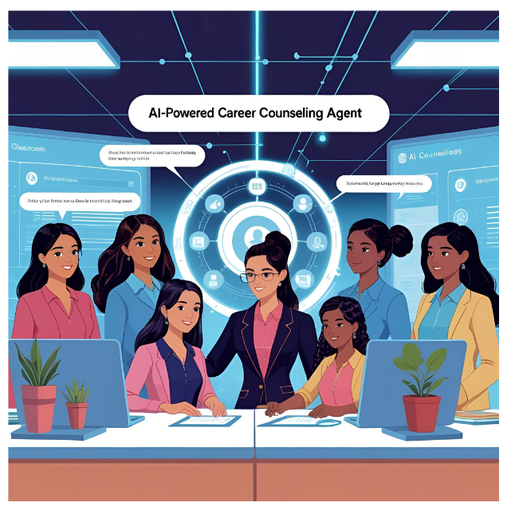
Future scope
Multilingual Career Guidance Support students in their native languages for better understanding and comfort.
Voice-Activated Career Assistant Enable hands-free interaction for accessible and intuitive guidance.
Real-Time Counselor Collaboration Allow students and counselors to interact simultaneously within the platform.
Personalized Career Roadmaps Generate step-by-step learning and development plans based on student profiles.
Integration with Learning Platforms Recommend and link to courses on Coursera, edX, IBM SkillsBuild, etc.

Slide 15
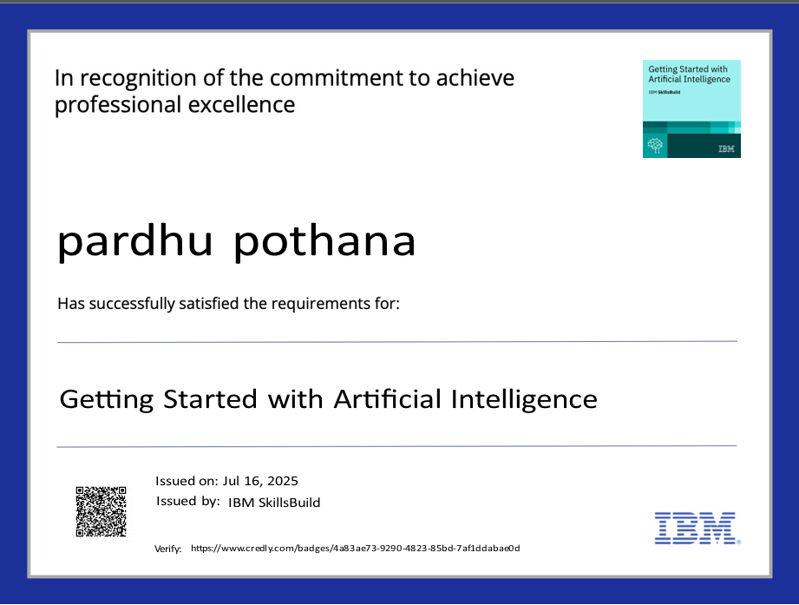
IBM Certifications
Getting started with artificial intelligence (credly certificate)

Slide 16

IBM Certifications
JOURNEY TO CLOUD : ENVISIONING YOUR SOLUTION (credly certificate)

Slide 17
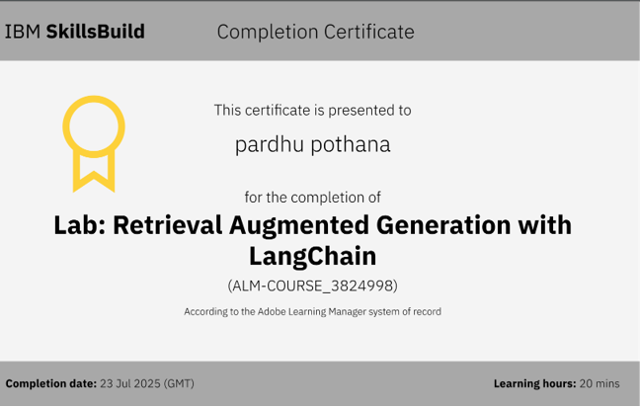
IBM Certifications
Lab : rag WITH LANGCHAIN ( IBM SKILLS BUILD)

Slide 18
THANK YOU

